Slide 1
Political System Model (David Easton)
S. M. Ali Reza, PhD
July 05. 2018

Slide 2
Easton’s System Model
The idea “system” has been one of the most popular, much-talked and thunderous concepts of the twentieth century.
What is a “System”?
A whole which functions as a whole by virtue of the inter-dependence of its parts is called a system.
Starting in the natural sciences, today ‘systems analysis’ has been broadly applied to numerous modes of analysis such as game theory, functional research or equilibrium theory.

Slide 3
Easton’s System Model
Pioneers of the ‘System Theory’: Herbert J. Spiro, Karl Deutsch, Gabriel A. Almond, Anatol Rapoport, Oran Young and David Easton, the most cited NAME related to this concept.
Easton’s Works that deal with “System Analysis”:
The Political System (1953),
A Framework for Political Analysis (1965).

Slide 4
Easton’s System Model
David Easton, in his pioneering work The Political Systems (1953), offered a major critique of the condition of political science as a discipline, and argued for use of the system concept “as an analytical tool designed to identify those integrally related of concrete social reality that can be called political” (P.61).
Over the succeeding decade, Easton adapted an ambitious attempt in his A Framework for Political Analysis (1965) to provide an analytical framework for the study of all phenomenon- social, political and physical- as behaving systems.

Slide 5
Easton’s System Model
What is a Political System?
A political system is “a goal-setting, self-transforming and creatively adaptive system.” The very fundamental task of any political system is “the authoritative allocation of values for a society” (David Easton).
Easton argues that “the primary goal of political analysis is to understand how political systems manage to persist through time.”

Slide 6
Easton’s System Model
Easton’s System Analysis, aims to-
Construct an empirically oriented general theory of politics;
Define the kind of functions characteristic of any political system through a systematic framework of political analysis;
Examine the basic processes through which a political system is able to persist as a system of behaviour in a world either of stability or of change.

Slide 7
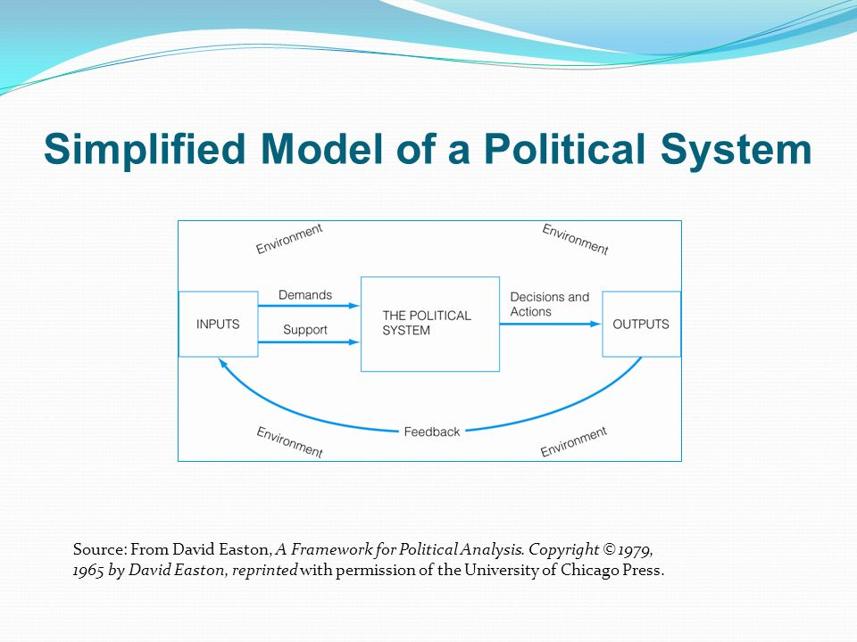
Easton’s System Model

Slide 8
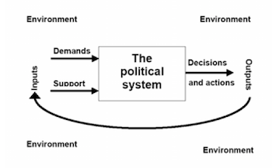
Easton’s System Model

Slide 9
Easton’s System Model
Four premises of Easton’s analysis:
System: It is useful to view political life as a system of behaviour.
Environment: A system is distinguishable from the environment in which it exists and is influenced by it.
Response: Variations in the structures and processes within a system may usefully be interpreted as constructive or positive alternative efforts by members of a system to regulate or cope with stress flowing from environmental as well as internal sources.
Feedback: The capacity of a system to persist in the face of stress is a function of the presence and nature of the information and other influences that return to its actors and decision-makers.

Slide 10
Easton’s System Model
The pattern of analysis involves the examination of the variables:
The nature of the inputs (changes in the environment relevant to the political system);
The variable conditions under which they will constitute a stressful disturbance on the system;
The environmental and systemic conditions that generate such stressful conditions; The typical ways in which systems have sought to cope with stress;
The role of information feedback;
The part that outputs play in these conversion and coping processes.

Slide 11
Easton’s System Model
Problems with ‘demands’ and ‘supports’:
Demands:
the politicization of raw preferences/ wants;
The volume and variety of demands are regulated by certain structures- interest groups, political parties, opinion leaders, or mass media (actors in the process);
Combination of the variety of demands in a workable and simplified program of action helps ‘the system’ respond more effectively;

Slide 12
Easton’s System Model
Since political capital of members differ (ranging from money, status, prestige and numbers), therefore, the effectiveness of demand relies on-
the access of members to the demand;
their voice to the demand.
Demands from members/ actors with more political capital generate effective response from the authorities of any political system.

Slide 13
Easton’s System Model
Supports:
Three levels of support: the authorities, the regime and the political community;
Support for each object varies independently although strong associative relationship normally involve a “spillover effect”-support for one object is transferred to others;
Political opposition: negative support;
Diffuse support: blind support (related to strong ties of loyalty and affection);
Specific support: specific demand-wise.

Slide 14
Easton’s System Model
“No system could endure for very long if it did not seek to build up a reservoir of support” (David Easton).
Output: system response to existing demands
No system can meet all of the demands of all of its members all of the time (Easton);
No system has an infinite capacity to accept and process all the demands;
Too many demands overload the system- “input overload;”

Slide 15
Easton’s System Model
Feedback:
The capacity of the system to respond effectively is derived from the central process of feedback, i.e., information about the state of the system and its environment which is communicated back to the authorities;
Effective feedback: maximum accuracy and minimum delay.

